Slide 1


CSB4301 – Theory of Computation
B.Tech – Vth Semester
Pumping Lemma
Department of Computer Science and Engineering

Slide 2
Properties of Regular Languages RL
Regular Languages are set of Languages which are accpeted by NFA, E NFA , DFA and Regular Expression.
Closure in an important property of RL ,where some operations among RLs will also result in RLs.
Example: Intersection of two Regular Languages are also Regular Language.

Slide 3
Proving Languages Not to be Regular
Not all languages are Regular
The following language is not regular
={01,0011,000111,00001111,…..}
We will prove this by a concept called as pumping lemma.

Slide 4
Pumping Lemma of Regular Languages
Let L be a Regular language then there exists a constant ‘n’(which depends on L) such that for ever string ‘w’ in L |w| >=n. n is the no of states in DFA which accepts the L.
We have to split w=xyz Such that
For all
1.
2.
3. For all k >0 X Y^{k} Z is also in L.
This means we can always find a y not too far from the beginning (rule 2) of w can be pumped (repeating n number of times) or removed (k=0) keeps the resulting string still in the language.

Slide 5
Pumping Lemma of Regular Languages
If L=L(A) for some DFA A. Suppose a has ‘n’ states.
Now consider a string of length ‘n’ or more
W=a₁ a₂ a₃..a_{m} where m>=n
We find the transition
δ(q0, a₁ a₂ a₃..a_{i})=p_{i} for i=0,1,2,..n
That is P_{i} is the state A is in after reading the first ‘i’ symbols of w.
By the pigeon hole principle is not possible for n+1 different p_{i’} s for i=0,1,..n to be distinct.
Since there are only ‘n’ different states. Thus we can find two different integers i and j such that 0 ≤ I ≤ j ≤ n such that p_{i} = p_{j} .

Slide 6
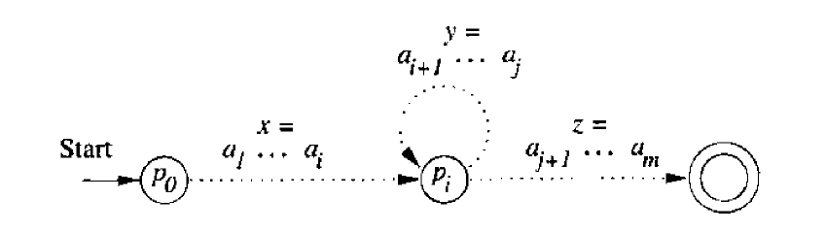
Pumping Lemma of Regular Languages
Now we break w=xyz
x=a₁ a₂ … a_{i}
y= a_{i+1} a_{i+2} … a_{j}
z= a_{j+1} a_{j+2} …. A_{m}
note here x and z can be empty but y cannot be empty as stated before.
Hence the point to understand is neither REs or FA s (DFA,E NFA, NFA) cannot be used for controlled string like equal number of 0’s and 1’s.

Slide 7
Closure properties of Regular Languages
The Union of two regular languages is regular.
The intersection of two regular languages is regular.
The Complement of two regular languages is regular.
The difference of two regular languages is regular.
The reversal of a regular language is regular.
The closure (*) of a regular language is regular.
The concatenation of two regular languages is regular.
The homomorphism of a regular language is regular.
The inverse homomorphism of a regular language is regular.

Slide 8
Complement of Regular Languages
Set of all strings that does not belong to that language is the complement of the language.
To obtain this complement is very simple
Convert the given language as RE
Then convert the RE into E NFA
Convert the E NFA to DFA.
In the DFA convert all accepting states as not accepting states and vice versa.

Slide 9
Homomorphism
A string homomorphism is a function on strings that works by substituting a particular string for each symbol.
Example
h(0)=ab
h(1)=ε
Then consider the string w=0011
Find h(0) h(0) h(1) h(1)=(ab)(ab)(ε)(ε)=abab.
This way also regular languages are preserved.

Slide 10
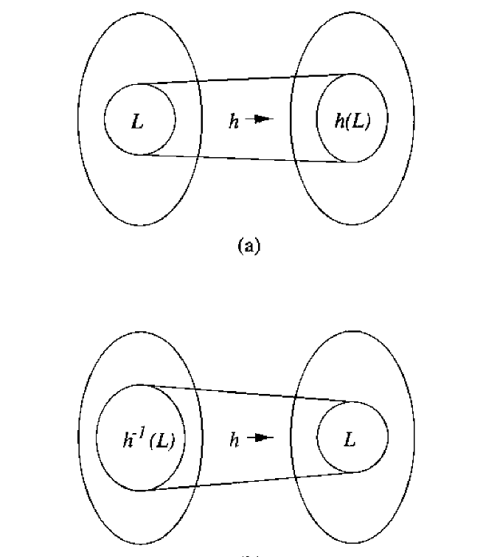
Inverse Homomorphism
A string homomorphism applied in reverse is called inverse homomorphism .
This way also regular languages are preserved.
Denoted by

Slide 11
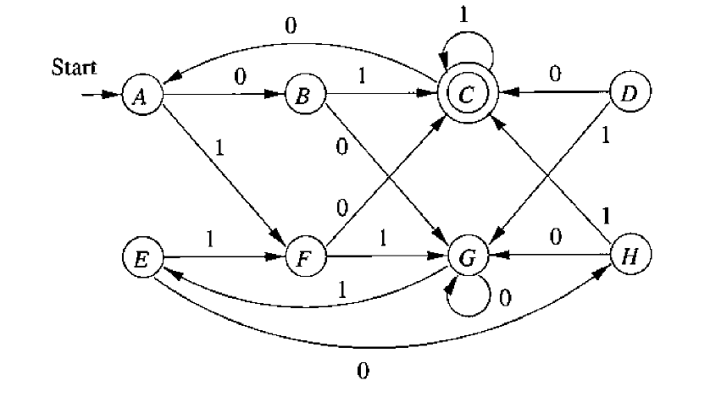
Finding the equivalency of states
In any given DFA two states can be equivalent if they behave identically in all situations.
Any two equivalent states can be merged together form a minimized DFA.

Slide 12
Finding the equivalency of states
For example if two states are accepting the they can be termed equivalent.
In a pair of states considered , if one state is accepting other is not then we say those two states are not equivalent (Distinguishable).
Two states p and q are said to be equivalent if δ*(p,w) and δ*(q,w) are same for all strings ‘w’.
Conversely two states are said to be distinguishable if δ*(p,w) and δ*(q,w) leads to either accepting or non accepting state.
Consider the states A and G in the DFA – Not Equivalent
Consider the states A and E in the DFA – Equivalent.

Slide 13
Finding the equiavalency of states
If we fail to prove the equivalency of states then those states are said to be distinguishable.

Slide 14
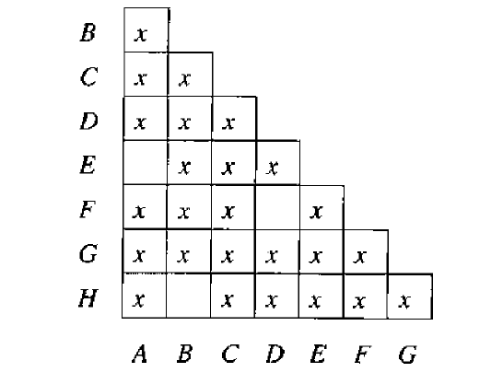
Finding the equivalency of states

